Slide 1
New and Emerging Technology
2020 Special

Slide 2
Outline of Task (SAC)
Written overview of all new tech topics. (following slides)
You are to put together a power point presentation of a chosen new tech topic.
You are to address the key questions to satisfy criterion 1 & 2 of the assessment criteria. (next slide)
The 4th criterion covers the presentation of slides and written quality; design, use of images/ diagrams, expression, grammar, spelling and punctuation.
The assignment will be assessed out of 50 30 marks.
A draft of each section will need to be sighted for each criteria before submission.
Power point must include a complete bibliography

Slide 3
New Tech Task (SAC)
Part 1: Students are to write an overview of each technology in their own words of 100 – 200 words. This will briefly include what it is, how it works and its applications. Word document submission.
Part 2: Students are to select one of the technologies for deeper exploration. This will be the basis for the power point presentation.
The following questions will need to be addressed;
What is the technology? and how does it work? (Description)
Where and what is the technology used for? (Application)
Advantages and disadvantages of the technology socially, economically and environmentally. (Evaluation)

Slide 4
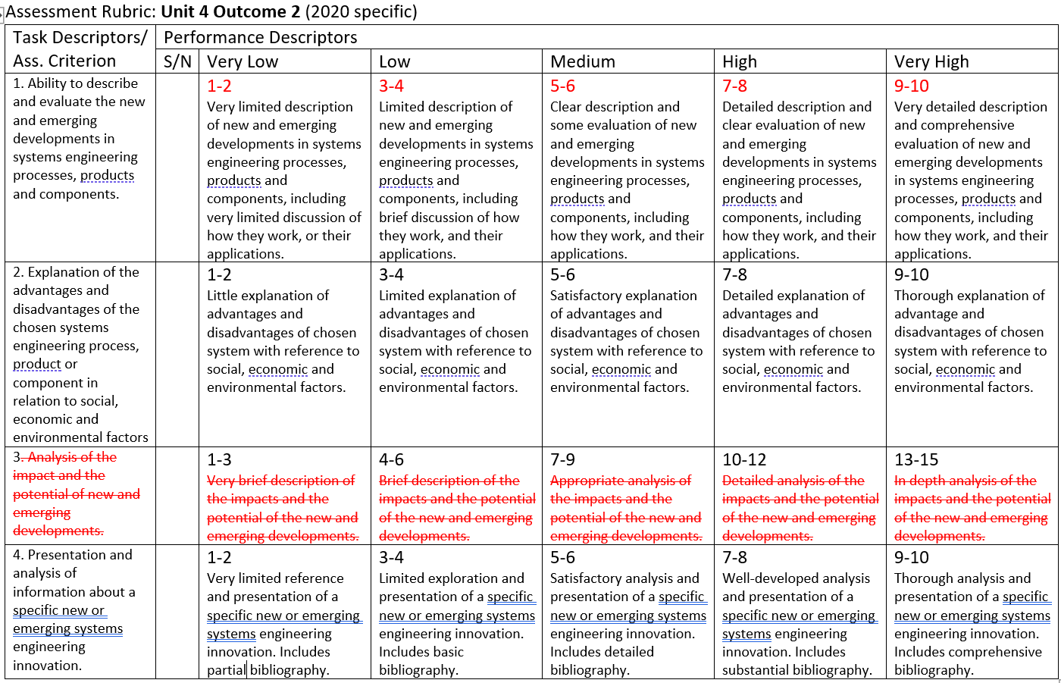

Slide 5
New and Emerging Technology Foci
Self driving car Technology
Virtual & Augmented Reality (VR/AR) Technology
Computer Vision
Ag Tech/ farm robotics

Slide 6
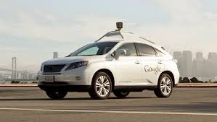
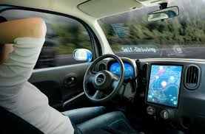
Driver Assist and Self-driving Car Technology
This is an autonomous or semi-autonomous system that uses sensors, lidar, GPS and computer vision to control a car to navigate a path to an intended destination. It is aware of its surroundings and can avoid obstacles and stop at dangerous situations such as with pedestrians and traffic lights.

Slide 7
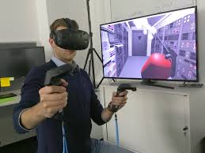
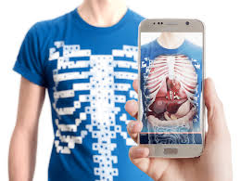
Virtual & Augmented Reality Technology
What is it?
Virtual Reality(VR) is an immersive experience in a computer generated environment that the user is made to feel part of and even interact with.
What is it?
Augmented Reality(AR) is a mixed experience of the computer generated with the real world, working to enhance and inform the real world experience.

Slide 8
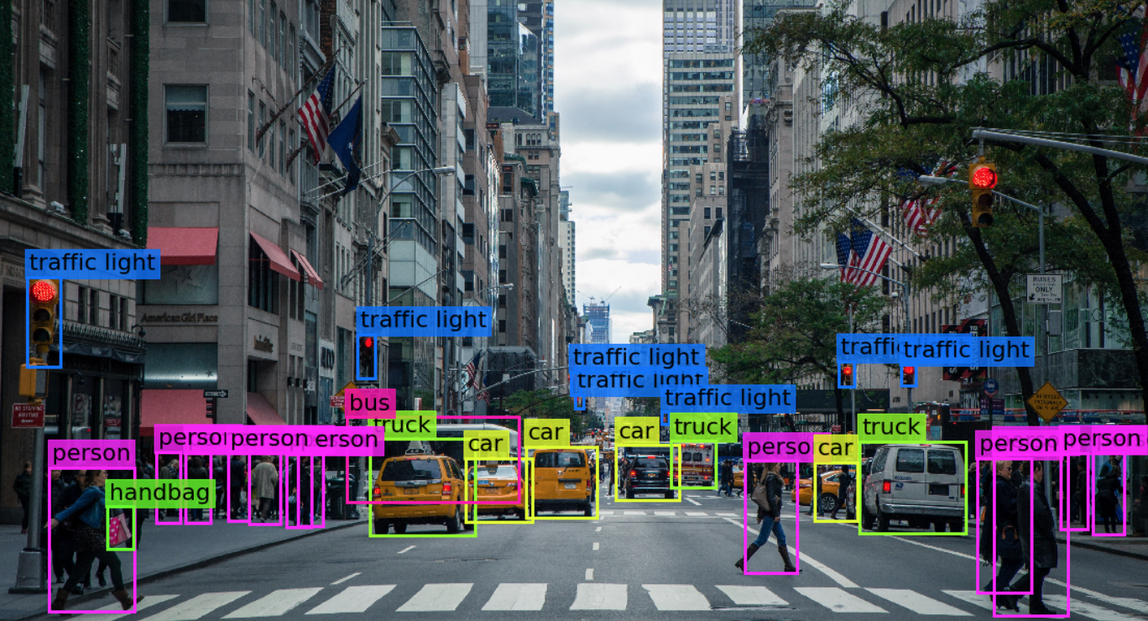
Computer Vision
This is a field that teaches computers and robots to see and have the ability to analyse what they see like humans do. This technology is being incorporated into self-driving cars, Farm robots and Augmented reality utilising machine learning object and facial recognition.

Slide 9
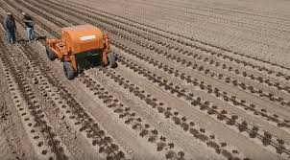
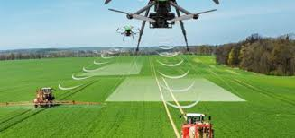
Ag-tech Farm Robotics Technology
This is the field that is bringing new technology like robotics and automation into the farming industries, to make farming more efficient reduce costs and increase yields for a growing population.

Slide 10
Description
What is the technology? And how does it work?

Slide 11
3D Printing – What is it?
3D printing is a new technology that has taken the principle of a computer printer used for making hard copy documents from an electronic version and extended it. A computer printer uses only two axis's to print on paper, 3D printing by its very name has included a 3rd axis to allow the printing of objects. Instead of an ink cartridge and jet sprayer, a heated unit called a print head is used to melt a continuously fed material and deposit it building an object up in layers. 3D printing has allowed computer designed 3 dimensional model to be printed for real world inspection or application.

Slide 12
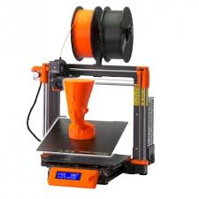
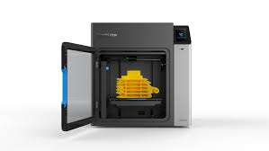
3D Printing – What is it?

Slide 13
3D Printing Technology – How it works?
This involves taking a computer designed model and breaking it down into thin horizontal layers called slicing, in a slicing program. This process creates a series of movement instructions called G-code, which the 3D printing machine can understanding. The 3D printer has 3 axes; the X axis, Y axis and Z axis, allowing it to move in 3 dimensions when printing. There are a number of techniques developing from the simple heated extrusion method popular with plastics, to laser fusion where polymer powder is deposited in layers and melted together with a laser and a new method is by laser hardening liquid resin in layers. The extrusion method is by far the most popular due to its low price and ease of use.

Slide 14
3D Printing Technology – How it works?
The printer is loaded up with the model for printing, which can be direct from the computer or transferred through an SD card. A reel of filament is loaded into the print head extruder and a start up sequence. Care is needed to chose the correct settings for the filament material being used as different plastics require different melt temperatures. The filament is a an extruded thread of material that is many metres long and usually 1.75mm in thickness. The start up sequence goes through and heats up the print bed; the area the model will be printed on and print head; that takes the filament and melts it to the right consistency for extrusion and printing. The outside edge is printed as well as the internal support material in a lattice structure for strength and to reduce the amount of material needed as air gaps are created.

Slide 15
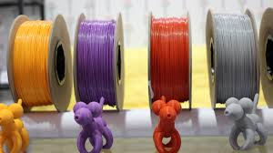
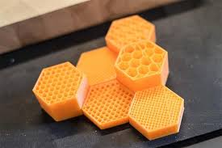
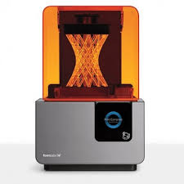
3D Printing Technology – How it works?
t
3D print Filament
Internal print structure
3D Resin Laser Printer

Slide 16
Application
Where and what is the technology used for?

Slide 17
Evaluation
Advantages and disadvantages of the technology socially, economically and environmentally

